Slide 1

CSE 445: Machine Learning
Support Vector Machines
Instructor: Syed Athar Bin Amir, North South University

Slide 2
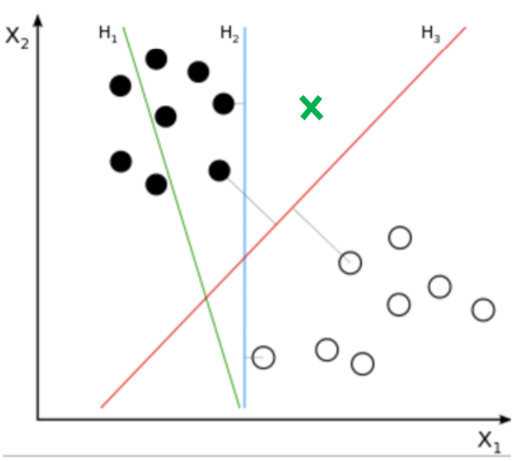
Support Vector Machine - Motivation
To which class would each decision boundary assign the new instance?
Which decision boundary would you choose to separate data?

Slide 3
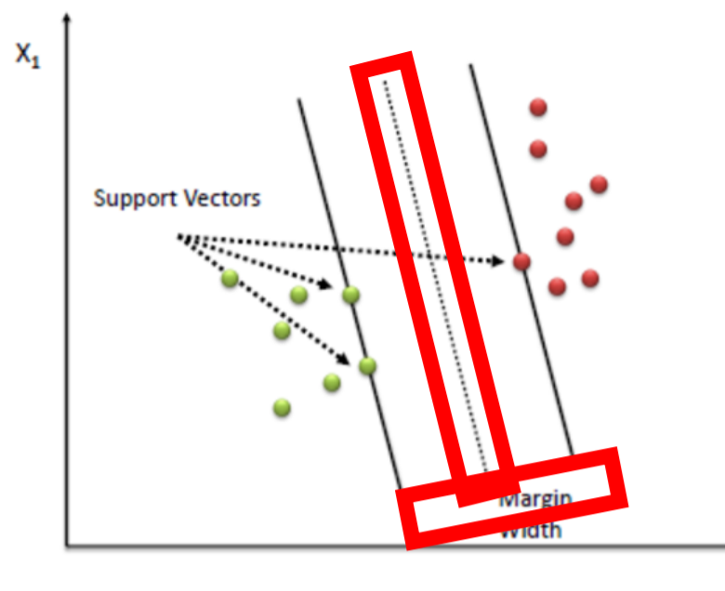
Support Vector Machines - Motivation
Choose hyperplane that maximizes the “margin” width
Margin → distance between the decision boundary (i.e. separating hyperplane) and training instances (“support vectors”) closest to the hyperplane

Slide 4
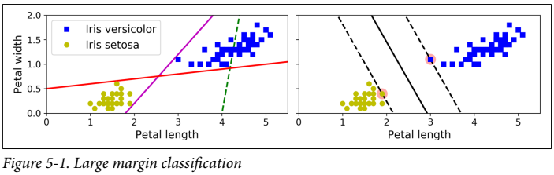
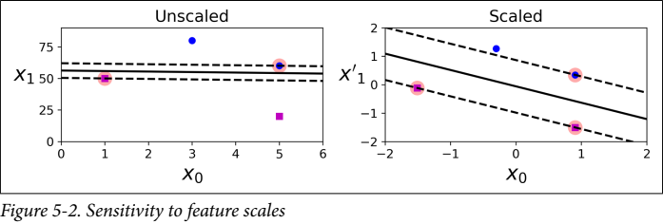
Support Vector Machine
Linear or nonlinear classification, regression, outlier detection
Excellent for small or medium sized datasets
Large margin classification - fit the widest possible street between the classes
More instances “off-the-street” does not affect decision boundary

Slide 5
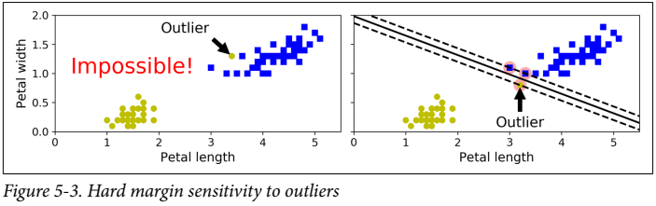
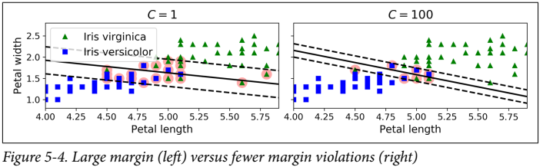
Soft Margin Classification
Can’t strictly enforce all training data to be on the correct side of the decision boundary (hard margin classification) – only works if it’s linearly separable
Adversely affected by outliers
Keep margin as wide as possible, while limiting margin violations
C → hyperparameter controlling number of margin violations

Slide 6
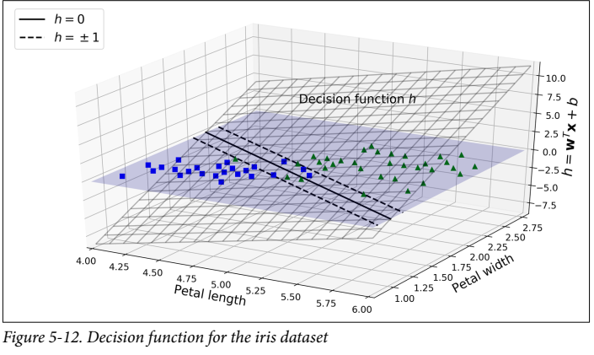
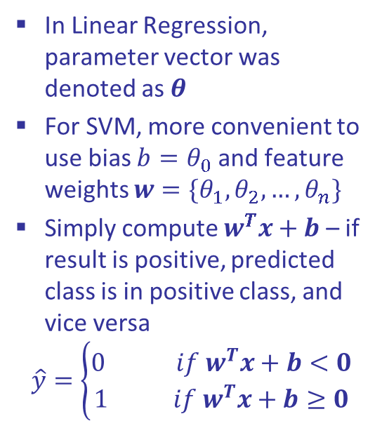
Hard Margin Classifier – Decision function
In Linear Regression, parameter vector was denoted as $θ$
For SVM, more convenient to use bias $b=θ_{0}$ and feature weights $w={\{θ}_{1},θ_{2},…,θ_{n}\}$
Simply compute $w^{T}x+b$ – if result is positive, predicted class is in positive class, and vice versa
$$\hat{y}=\left\{\begin{aligned}0 if w^{T}x+b<0 \\ 1 if w^{T}x+b≥0\end{aligned}\right.$$

Slide 7
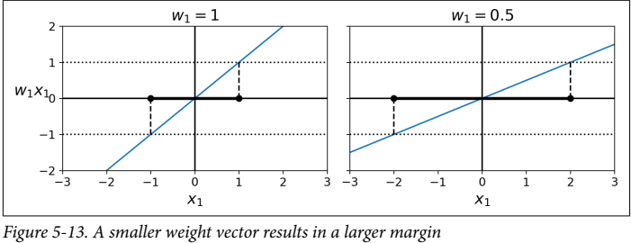

Training Objective
Slope of the decision function is equal to the norm of the weight vector $\left\|w\right\|$
Smaller weight vector $w$ means larger margin
Minimize $\left\|w\right\|$ to get a large margin, while avoiding margin violations

Slide 8
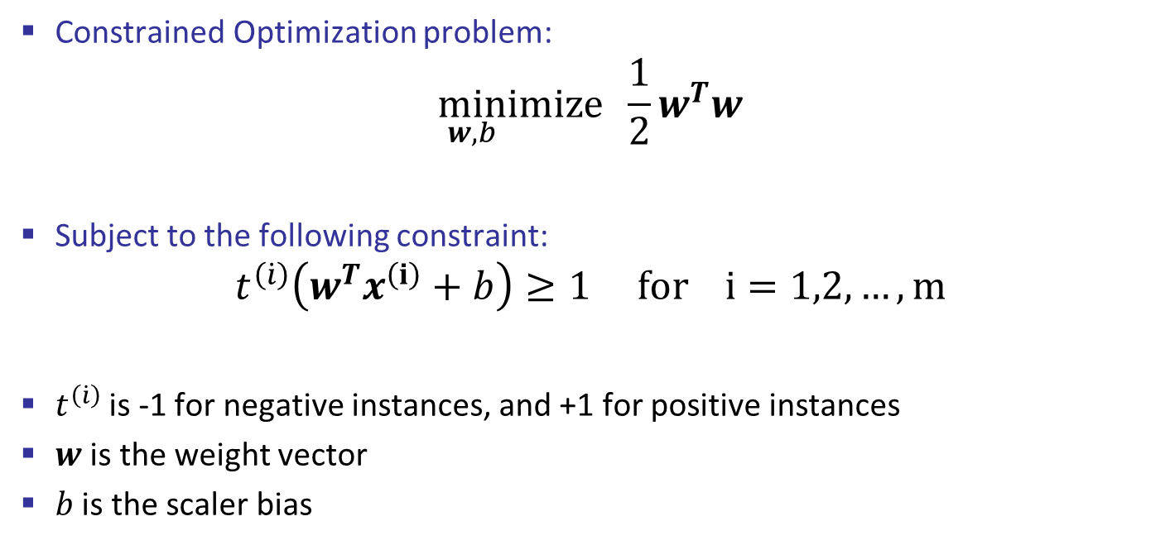
Hard Margin Classifier Objective
Constrained Optimization problem:
$$\min_{w,b}ⅈmize \frac{1}{2}w^{T}w$$
Subject to the following constraint:
$$t^{\left(\dot{i}\right)}\left(w^{T}x^{\left(ⅈ\right)}+b\right)≥1 for i=1,2,…,m$$
$t^{\left(\dot{i}\right)}$ is -1 for negative instances, and +1 for positive instances
$w$ is the weight vector
$b$ is the scaler bias

Slide 9
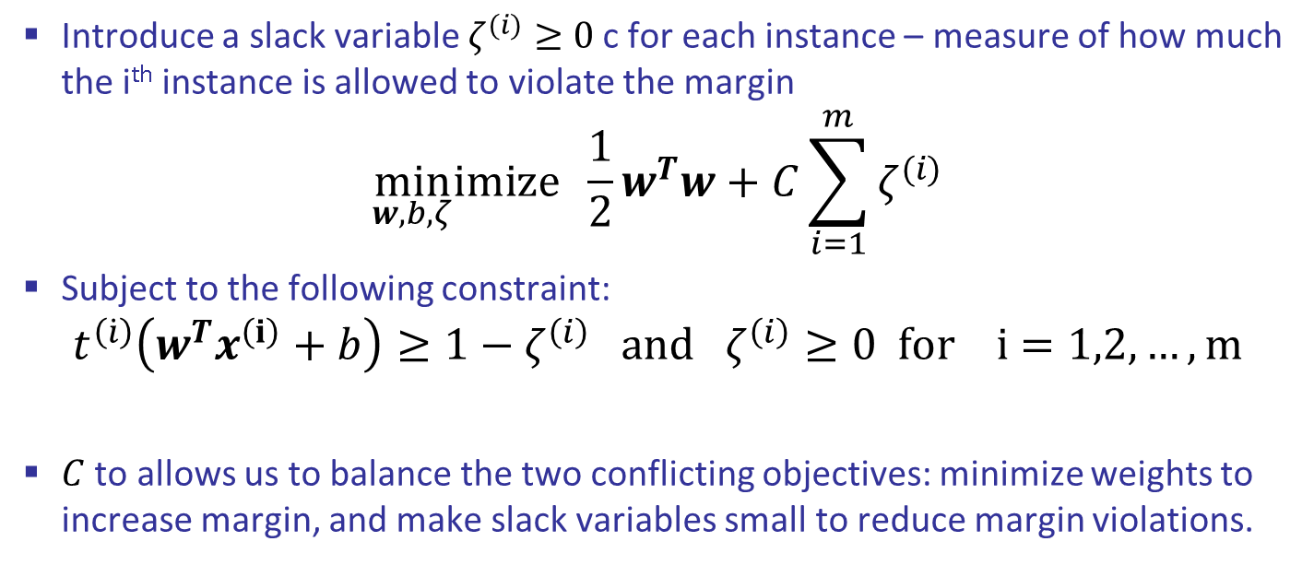
Soft Margin Classifier Objective
Introduce a slack variable $ζ^{(i)}≥0$ c for each instance – measure of how much the i^{th} instance is allowed to violate the margin
$$\min_{w,b,ζ}ⅈmize \frac{1}{2}w^{T}w+C\sum_{i=1}^{m}{ζ^{(i)}}$$
Subject to the following constraint:
$$t^{\left(\dot{i}\right)}\left(w^{T}x^{\left(ⅈ\right)}+b\right)≥1−ζ^{\left(i\right)} and ζ^{\left(i\right)}≥0 for i=1,2,…,m$$
$C$ to allows us to balance the two conflicting objectives: minimize weights to increase margin, and make slack variables small to reduce margin violations.

Slide 10
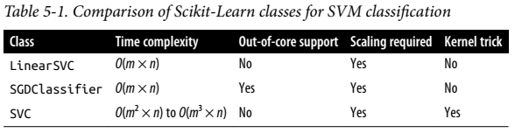
Computational Complexity
LinearSVC → used for linear SVMs, and scales linearly with number of training instances and features
SVC → based on libsvm library, supports the kernel trick, but doesn’t scale linearly with number of instances [very good for small datasets wrt number of instances]

Slide 11
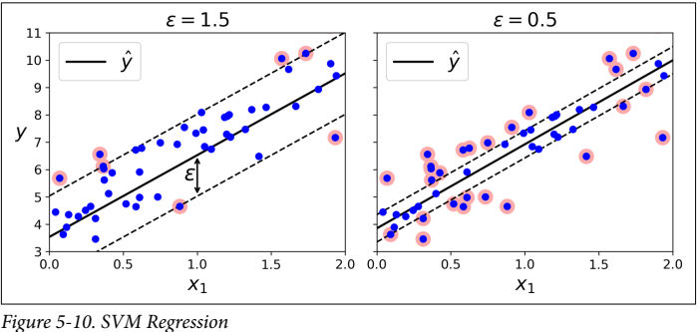

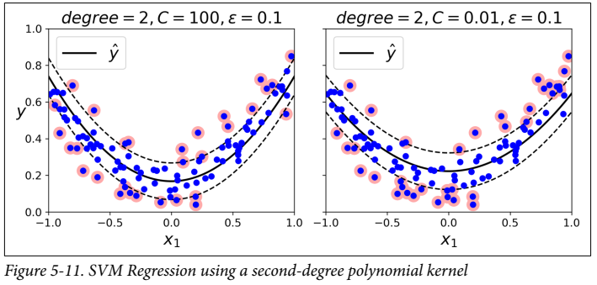

Support Vector Regression
Reverse objective from classification → try to fit as many instances as possible on the street, while limiting margin violations
Adding more instances within the margin does not affect predictions → ϵ insensitive
For nonlinear regression tasks, use kernelized SVM model in SVR

Slide 12
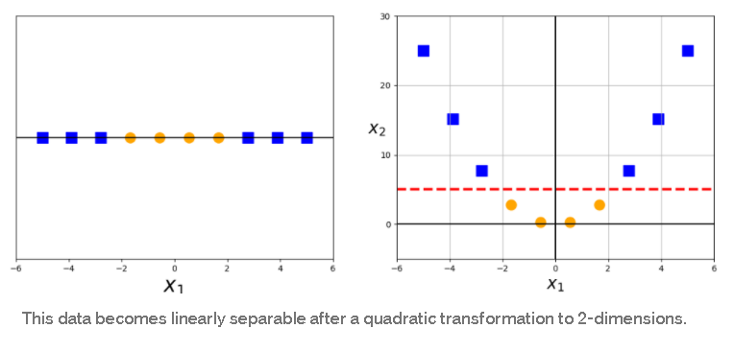
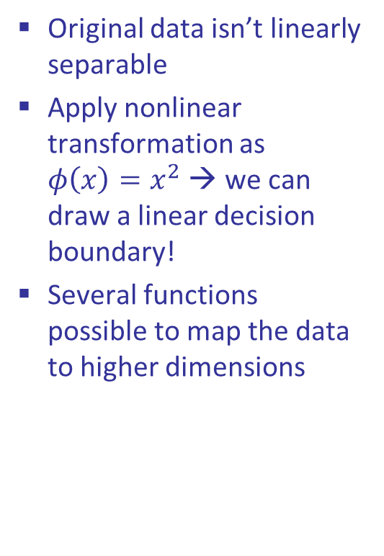
Nonlinear Transformations – 1D
If data isn’t linearly separable in the original space → map it to a higher dimensional feature space
Original data isn’t linearly separable
Apply nonlinear transformation as $φ\left(x\right)=x^{2}$ → we can draw a linear decision boundary!
Several functions possible to map the data to higher dimensions

Slide 13
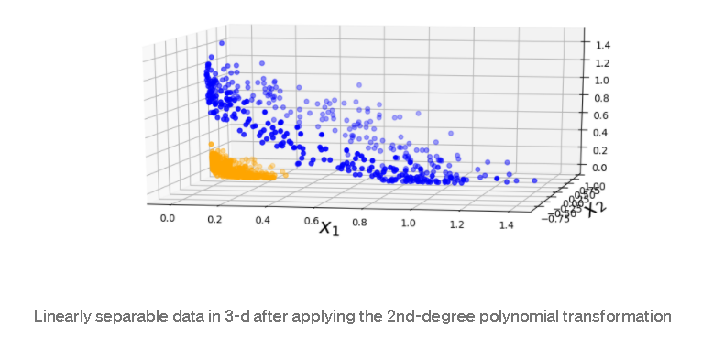
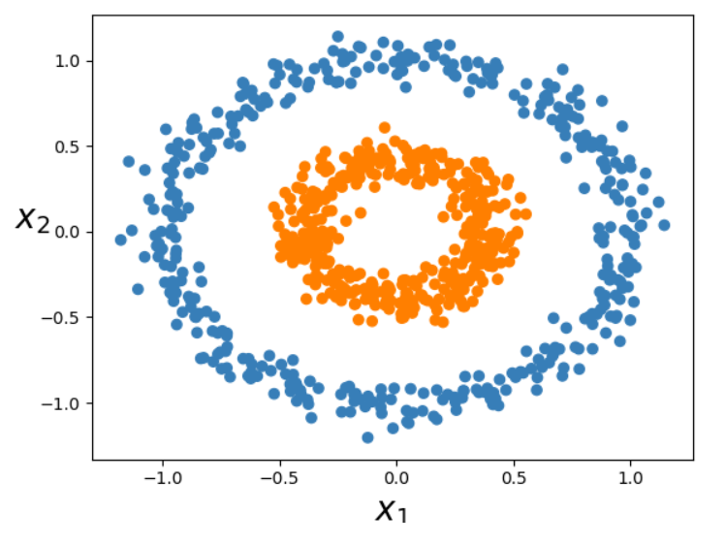

Nonlinear Transformations – 2D
Applying a second-degree polynomial mapping →
$$φ\left(x\right)=φ\left(\left(\begin{matrix}x_{1} \\ x_{2}\end{matrix}\right)\right)=\left(\begin{matrix}x_{1}^{2} \\ \sqrt{2}x_{1}x_{2} \\ x_{2}^{2}\end{matrix}\right)$$
Note: Transformed vector is 3D!

Slide 14
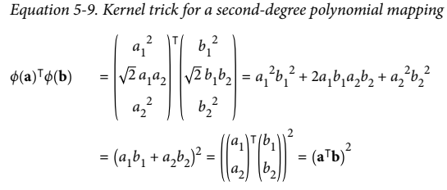
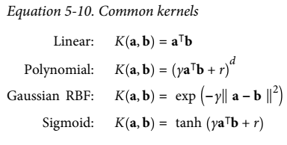
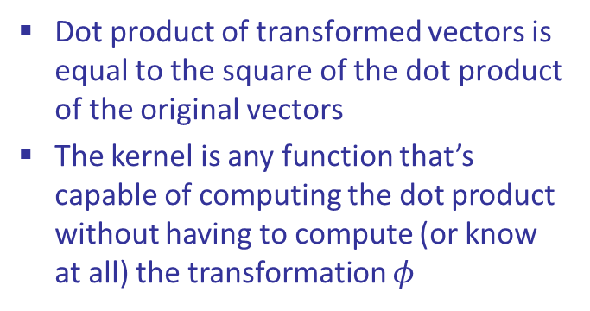
Kernel Trick
Kernel function → takes vectors in the original lower dimensional space as inputs, and returns the dot product of the transformed vectors in the higher dimensional feature space
Consider a couple of 2D vectors a,b
Dot product of transformed vectors is equal to the square of the dot product of the original vectors
The kernel is any function that’s capable of computing the dot product without having to compute (or know at all) the transformation $φ$

